Slide 1
Cool Microcontroller Projects AC Current Sensor
Dave VE3OOI
Feb 2021

Slide 2
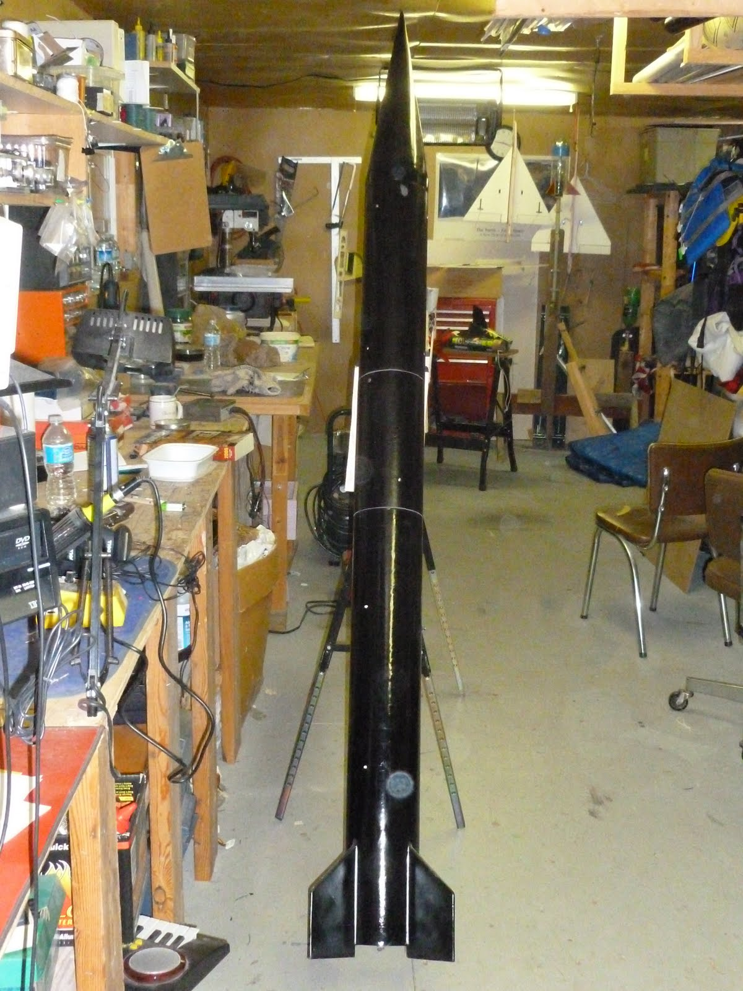
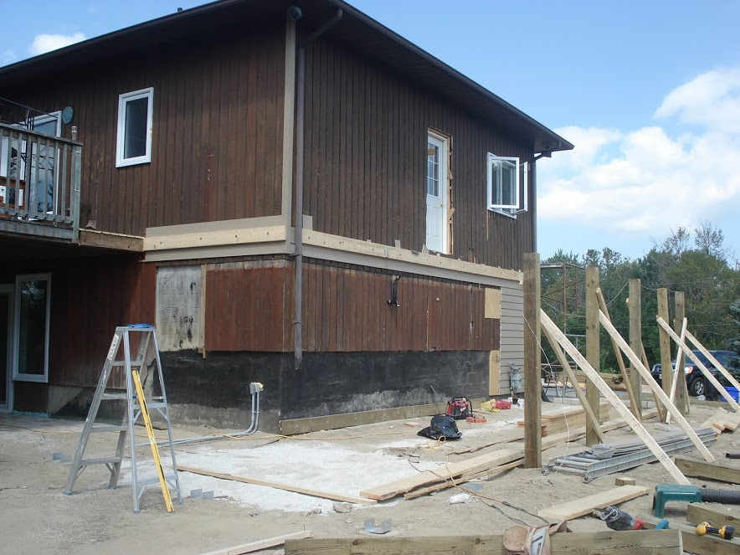
BACKGROUND
Renovations to house 2007
Added a large Shed (underside of deck)
AC Heater
Needed to estimate cost for a 110V Portable Heater
Objective to identify time heater was on and estimate costs based on wattage

Slide 3
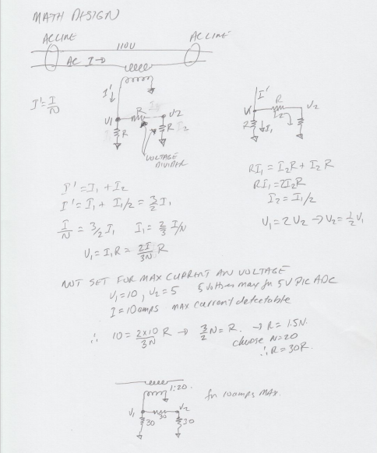
Noodling
Use similar technique for a Return Loss Bridge
1 Turn through toroid and secondary pickup
Detect voltage on pickup with PIC uController (16F88)
Store how long current was detected

Slide 4
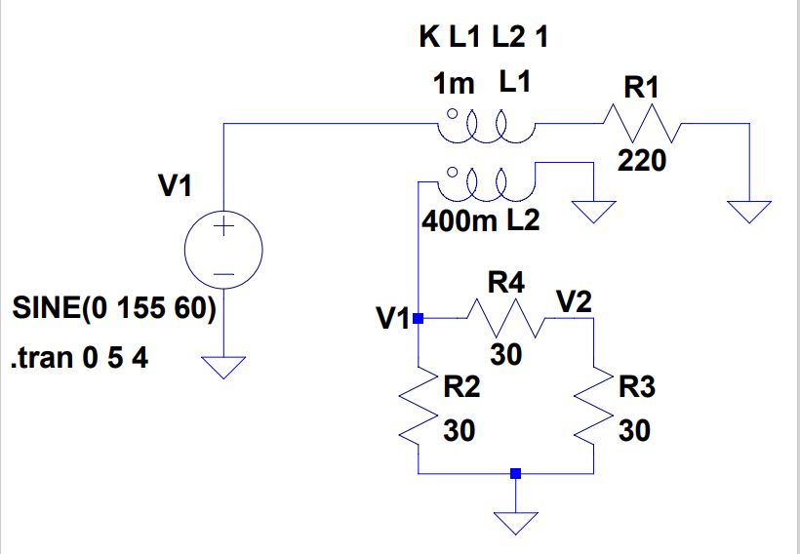
INITIAL CIRCUIT
Didn’t have proper toroid for 60 Hz.
Voltage too low on secondary to detect
Had to wing it and use an opamp to amplify signal so uController could detect it.

Slide 5
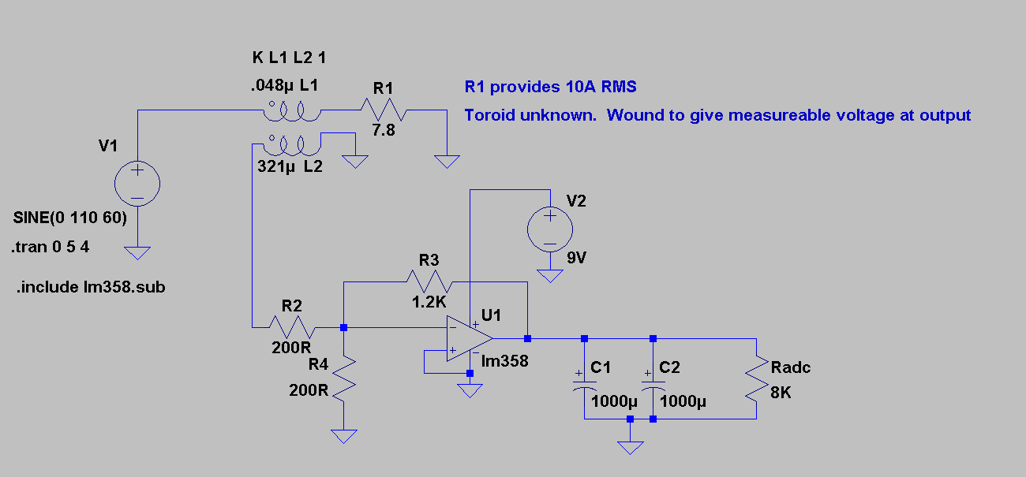
ACTUAL CIRCUIT
Gain x6
With 10A get 137 mV peak
R4 for current sensing

Slide 6
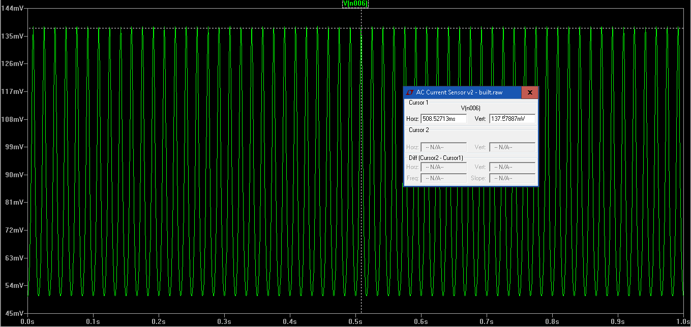
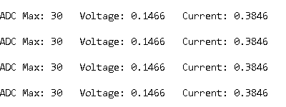
PREDICTED RESULTS

Slide 7
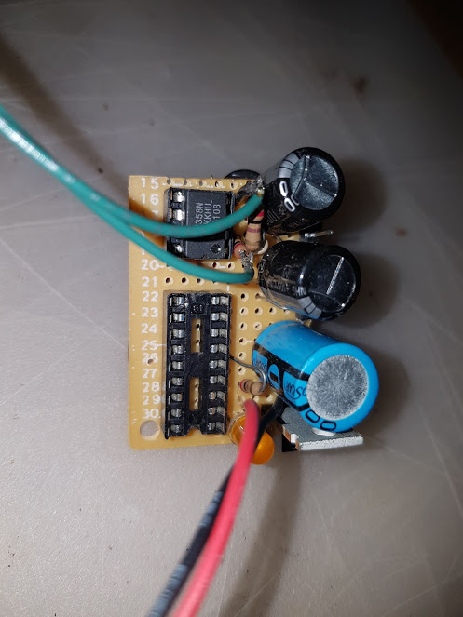
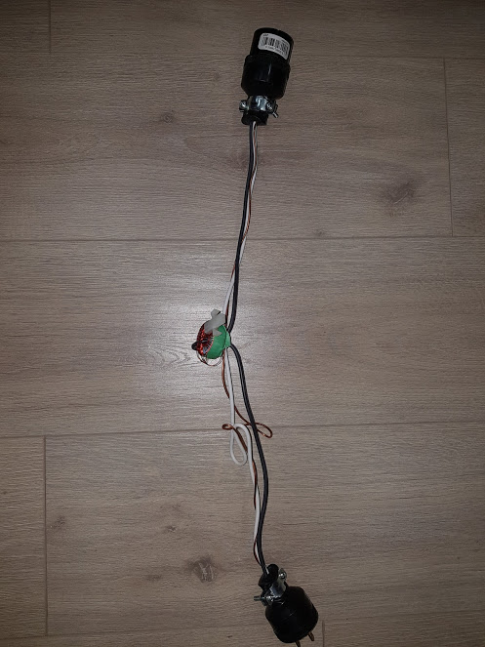
BUILD

Slide 8
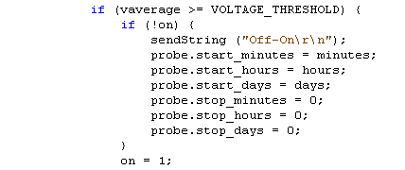
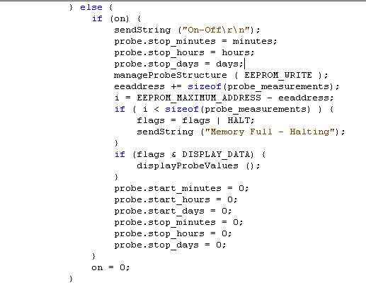
SOFTWARE
Voltage is present and heater is ON
First time voltage detected so save start time
Set flag to know heater is ON – i.e. remember its ON
Voltage is NOT present, and heater is OFF
First time voltage detected as off so save stop time
Set flag to know heater is OFF – i.e. remember its OFF

Slide 9
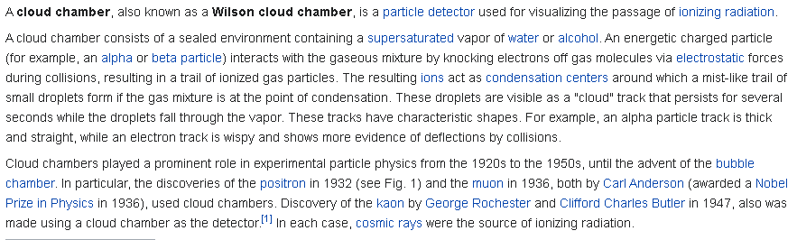
FIN

